Slide 1
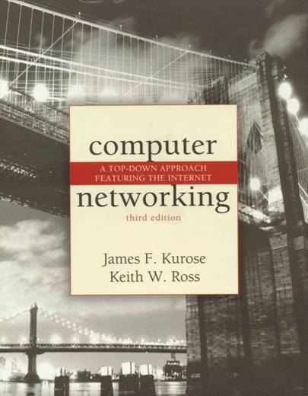
Chapter 2 Application Layer
A note on the use of these ppt slides:
We’re making these slides freely available to all (faculty, students, readers). They’re in PowerPoint form so you can add, modify, and delete slides (including this one) and slide content to suit your needs. They obviously represent a lot of work on our part. In return for use, we only ask the following:
If you use these slides (e.g., in a class) in substantially unaltered form, that you mention their source (after all, we’d like people to use our book!)
If you post any slides in substantially unaltered form on a www site, that you note that they are adapted from (or perhaps identical to) our slides, and note our copyright of this material.
Thanks and enjoy! JFK/KWR
All material copyright 1996-2006
J.F Kurose and K.W. Ross, All Rights Reserved
Computer Networking: A Top Down Approach Featuring the Internet, 3rd edition. Jim Kurose, Keith Ross Addison-Wesley, July 2004.
2: Application Layer
‹#›

Slide 2
Web and HTTP
First some jargon
Web page consists of objects
Object can be HTML file, JPEG image, Java applet, audio file,…
Web page consists of base HTML-file which includes several referenced objects
Each object is addressable by a URL
Example URL:
www.someschool.edu/someDept/pic.gif
host name
path name
2: Application Layer
‹#›

Slide 3

HTTP overview
HTTP: hypertext transfer protocol
Web’s application layer protocol
client/server model
client: browser that requests, receives, “displays” Web objects
server: Web server sends objects in response to requests
HTTP 1.0: RFC 1945
HTTP 1.1: RFC 2068
HTTP request
PC running
Explorer
HTTP response
HTTP request
Server
running
Apache Web
server
HTTP response
Mac running
Navigator
2: Application Layer
‹#›

Slide 4
HTTP overview (continued)
Uses TCP:
client initiates TCP connection (creates socket) to server, port 80
server accepts TCP connection from client
HTTP messages (application-layer protocol messages) exchanged between browser (HTTP client) and Web server (HTTP server)
TCP connection closed
HTTP is “stateless”
server maintains no information about past client requests
aside
Protocols that maintain “state” are complex!
past history (state) must be maintained
if server/client crashes, their views of “state” may be inconsistent, must be reconciled
2: Application Layer
‹#›

Slide 5
HTTP connections
Nonpersistent HTTP
At most one object is sent over a TCP connection.
HTTP/1.0 uses nonpersistent HTTP
Persistent HTTP
Multiple objects can be sent over single TCP connection between client and server.
HTTP/1.1 uses persistent connections in default mode
2: Application Layer
‹#›

Slide 6
Nonpersistent HTTP
(contains text,
references to 10
jpeg images)
Suppose user enters URL www.someSchool.edu/someDepartment/home.index
1a. HTTP client initiates TCP connection to HTTP server (process) at www.someSchool.edu on port 80
1b. HTTP server at host www.someSchool.edu waiting for TCP connection at port 80. “accepts” connection, notifying client
2. HTTP client sends HTTP request message (containing URL) into TCP connection socket. Message indicates that client wants object someDepartment/home.index
3. HTTP server receives request message, forms response message containing requested object, and sends message into its socket
time
2: Application Layer
‹#›

Slide 7
Nonpersistent HTTP (cont.)
4. HTTP server closes TCP connection.
5. HTTP client receives response message containing html file, displays html. Parsing html file, finds 10 referenced jpeg objects
time
6. Steps 1-5 repeated for each of 10 jpeg objects
2: Application Layer
‹#›

Slide 8
Non-Persistent HTTP: Response time
Definition of RTT: time to send a small packet to travel from client to server and back.
Response time:
one RTT to initiate TCP connection
one RTT for HTTP request and first few bytes of HTTP response to return
file transmission time
total = 2RTT+transmit time
initiate TCP
connection
RTT
request
file
RTT
time to
transmit
file
file
received
time
time
2: Application Layer
‹#›

Slide 9
Persistent HTTP
Nonpersistent HTTP issues:
requires 2 RTTs per object
OS overhead for each TCP connection
browsers often open parallel TCP connections to fetch referenced objects
Persistent HTTP
server leaves connection open after sending response
subsequent HTTP messages between same client/server sent over open connection
Persistent without pipelining:
client issues new request only when previous response has been received
one RTT for each referenced object
Persistent with pipelining:
default in HTTP/1.1
client sends requests as soon as it encounters a referenced object
as little as one RTT for all the referenced objects
2: Application Layer
‹#›

Slide 10
HTTP request message
two types of HTTP messages: request, response
HTTP request message:
ASCII (human-readable format)
request line
(GET, POST,
HEAD commands)
GET /somedir/page.html HTTP/1.1
Host: www.someschool.edu
User-agent: Mozilla/4.0
Connection: close
Accept-language:fr
(extra carriage return, line feed)
header
lines
Carriage return,
line feed
indicates end
of message
2: Application Layer
‹#›

Slide 11
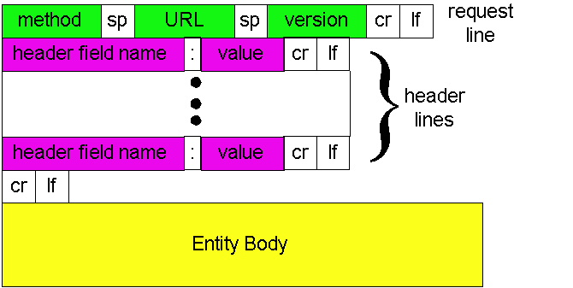
HTTP request message: general format
2: Application Layer
‹#›

Slide 12
Uploading form input
Post method:
Web page often includes form input
Input is uploaded to server in entity body
URL method:
Uses GET method
Input is uploaded in URL field of request line:
www.somesite.com/animalsearch?monkeys&banana
2: Application Layer
‹#›

Slide 13
Method types
HTTP/1.0
GET
POST
HEAD
asks server to leave requested object out of response
HTTP/1.1
GET, POST, HEAD
PUT
uploads file in entity body to path specified in URL field
DELETE
deletes file specified in the URL field
2: Application Layer
‹#›

Slide 14
Method Types
The first line of an HTTP request message is called the request line; the subsequent lines are called the header lines. The request line has three fields: the method field, the URL field, and the HTTP version field.
The method field can take on several different values, including GET, POST, HEAD, PUT, and DELETE.
The great majority of HTTP request messages use the GET method. The GET method is used when the browser requests an object, with the requested object identified in the URL field.
2: Application Layer
‹#›

Slide 15
GET vs POST Method
The entity body is empty with the GET method, but is used with the POST method.
An HTTP client often uses the POST method when the user fills out a form—for example, when a user provides search words to a search engine.
With a POST message, the user is still requesting a Web page from the server, but the specific contents of the Web page depend on what the user entered into the form fields.
If the value of the method field is POST, then the entity body contains what the user entered into the form fields.
2: Application Layer
‹#›

Slide 16
HEAD, PUT, and DELETE
The HEAD method is similar to the GET method. When a server receives a request with the HEAD method, it responds with an HTTP message but it leaves out the requested object. Application developers often use the HEAD method for debugging.
The PUT method is often used in conjunction with Web publishing tools. It allows a user to upload an object to a specific path (directory) on a specific Web server.
The PUT method is also used by applications that need to upload objects to Web servers.
The DELETE method allows a user, or an application, to delete an object on a Web server.
2: Application Layer
‹#›

Slide 17
HTTP response message
status line
(protocol
status code
status phrase)
HTTP/1.1 200 OK
Connection close
Date: Thu, 06 Aug 1998 12:00:15 GMT
Server: Apache/1.3.0 (Unix)
Last-Modified: Mon, 22 Jun 1998 …...
Content-Length: 6821
Content-Type: text/html
data data data data data ...
header
lines
data, e.g.,
requested
HTML file
2: Application Layer
‹#›

Slide 18
HTTP response status codes
In first line in server->client response message.
A few sample codes:
200 OK
request succeeded, requested object later in this message
301 Moved Permanently
requested object moved, new location specified later in this message (Location:)
400 Bad Request
request message not understood by server
404 Not Found
requested document not found on this server
505 HTTP Version Not Supported
2: Application Layer
‹#›

Slide 19
Thank You
2: Application Layer
‹#›

